Slide 1
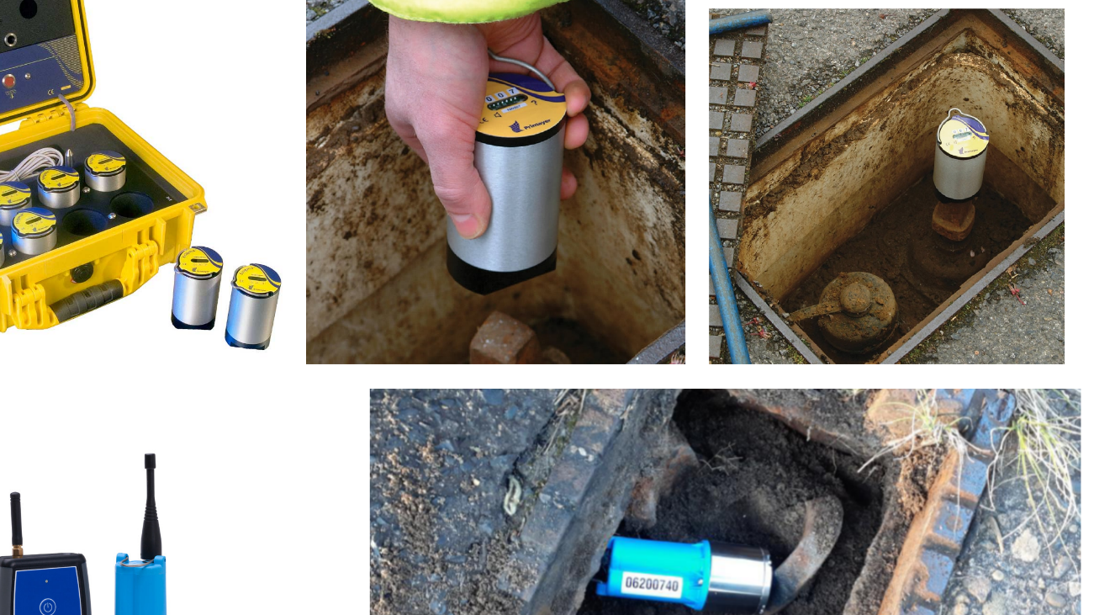
Water Loss Reduction & Drought Resilience Project
Dover & Foxcroft Water District
The Dover-Foxcroft Water District respectfully requests funding to support the Water Loss Reduction & Drought Resilience Project, which will implement advanced acoustic leak detection technology to identify and repair leaks within the distribution system. As drought conditions in Maine place increasing pressure on available water resources, reducing system losses is critical to maintaining a sustainable supply. Water lost through leaks represents treated and pumped water that is never delivered to customers, resulting in wasted energy, increased operational costs, and reduced system capacity. By deploying permanently installed monitoring devices capable of real-time leak detection and remote data analysis, the District will improve response times, reduce non-revenue water, and conserve both water and energy. This project will strengthen long-term water reliability, improve system efficiency, and support responsible resource management in the face of changing climate conditions.

